Slide 1
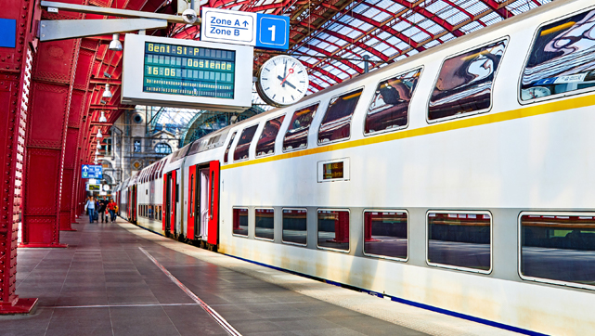
The Belgian Rail Revolution
SUNLENZ INDUSTRIES

Slide 2
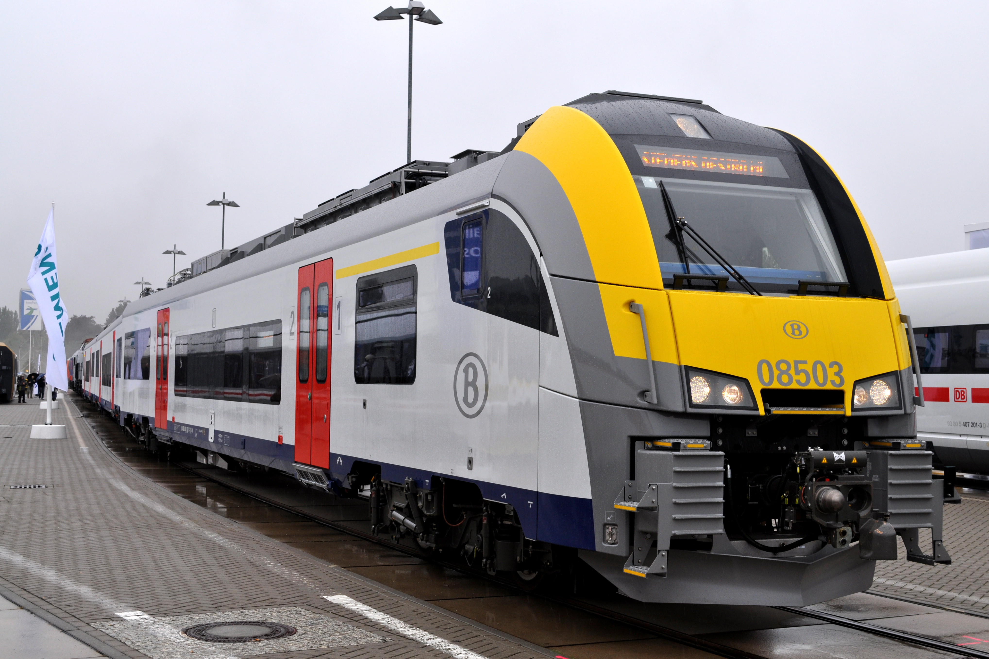
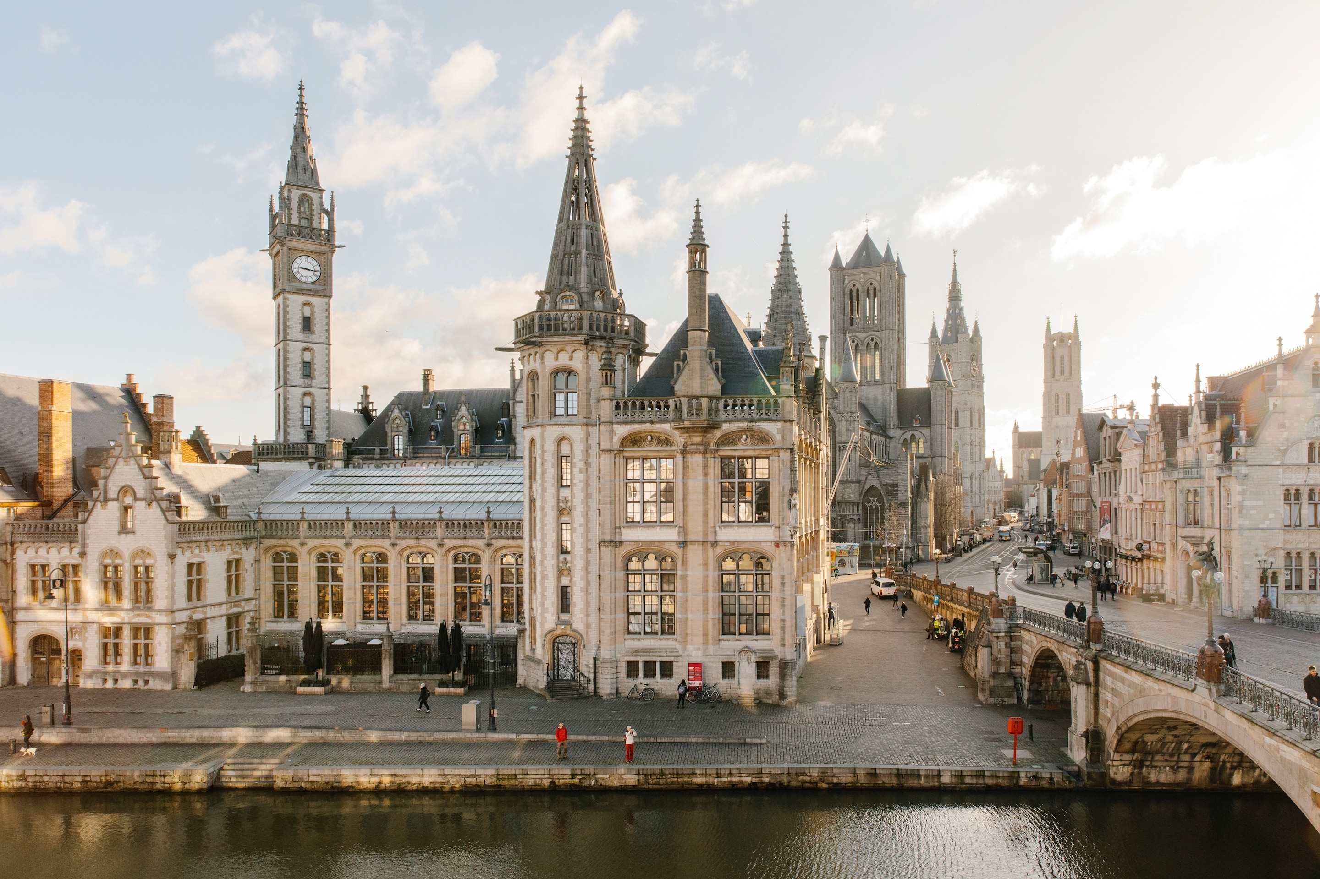

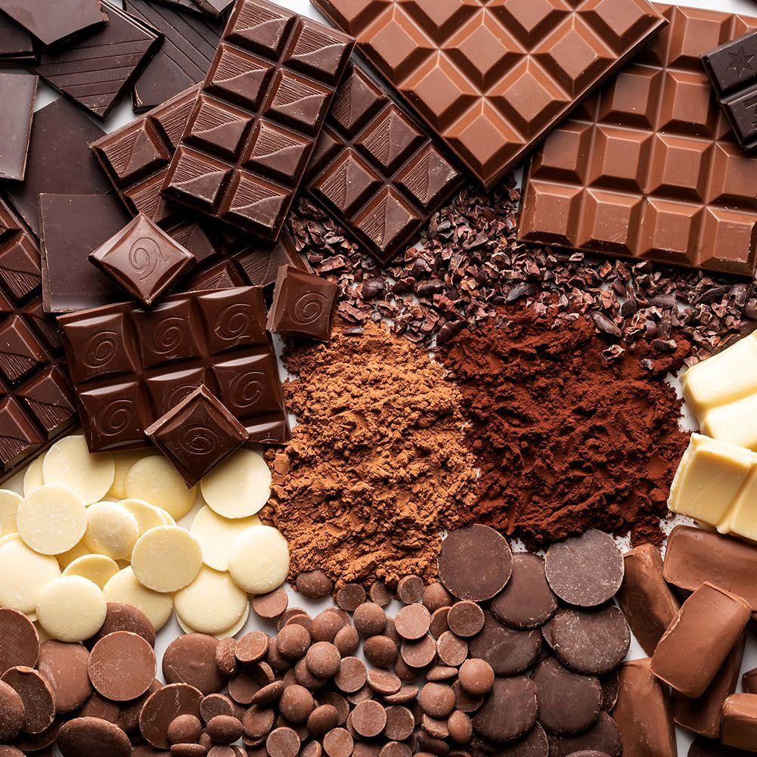
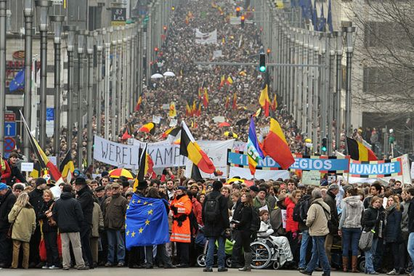
244,000,000 trips each year!

Slide 3
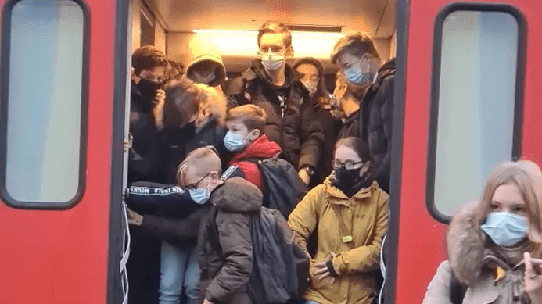
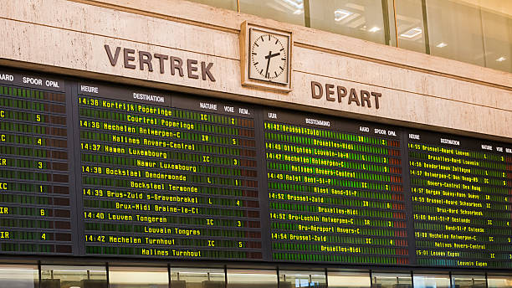
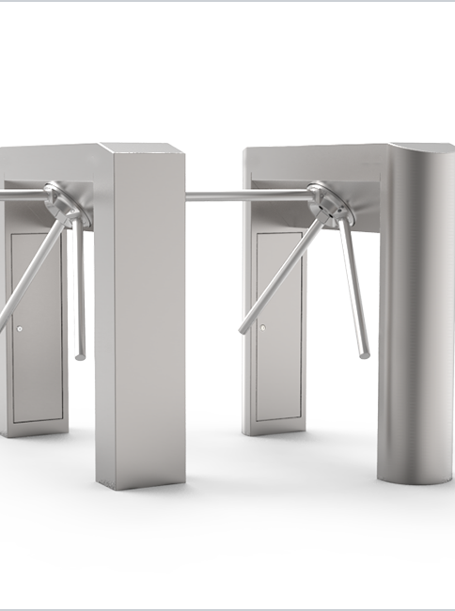

The Problem

Slide 4

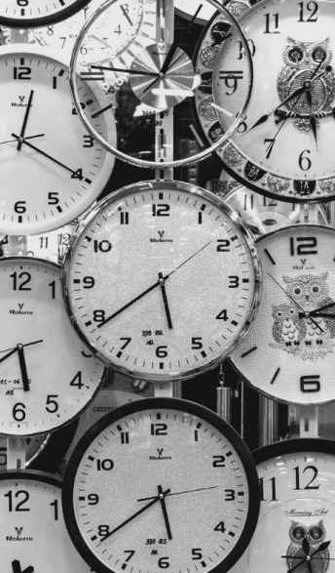


Slide 5

Introducing: SchedulRail!
SchedulRail
Please input schedule below
Line:
Date:
Train 1:
Time:
From:
To:
Train 2:
Time:
From:
To:
Train 3:
Time:
From:
To:
ADD TRAIN
GO!

Slide 6

Easy-to-use Interface!
SchedulRail
SchedulRail
SchedulRail
Welcome Niels!
Please input schedule below
Loading Results
Please Wait
Train 1:
Line:
Crowding
Risk
LOW
Date:
Train 1:
Time:
Train 2:
From:
To:
Crowding
Risk
HIGH
Train 2:
Time:
From:
Train 3:
To:
Train 3:
Crowding
Risk
LOW
Time:
From:
To:
ADD TRAIN
GO!
RESTART

Slide 7


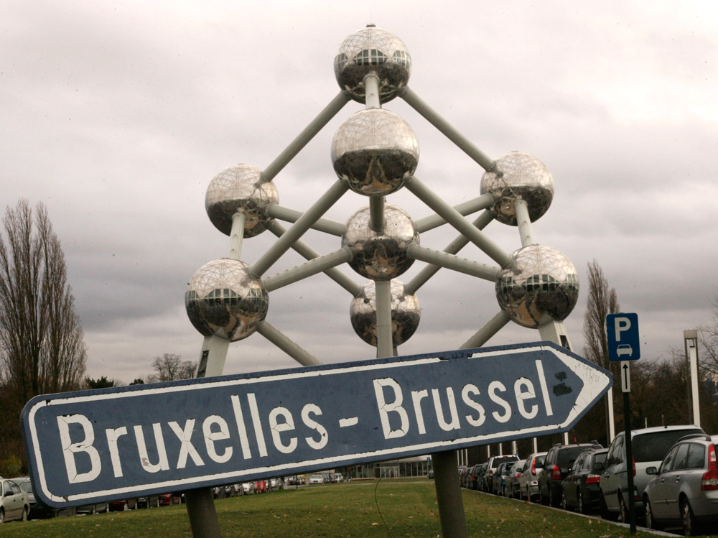
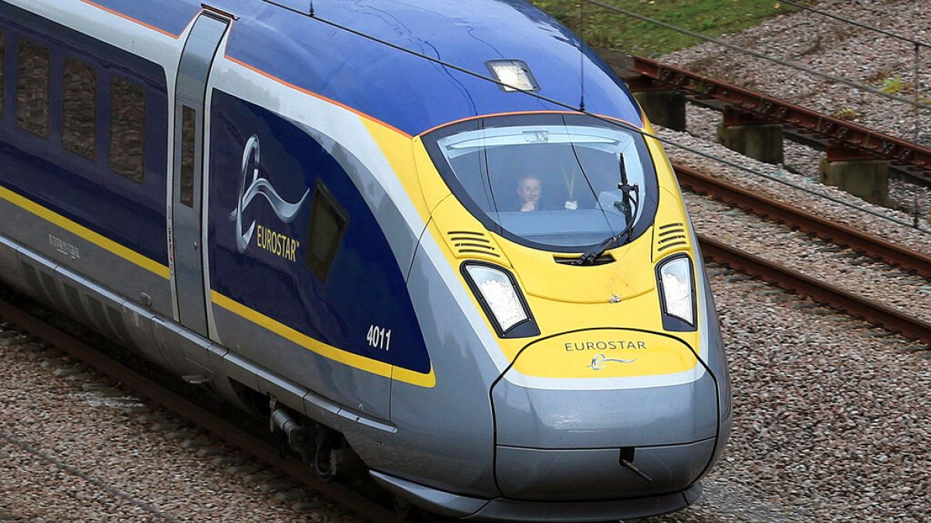


Slide 8
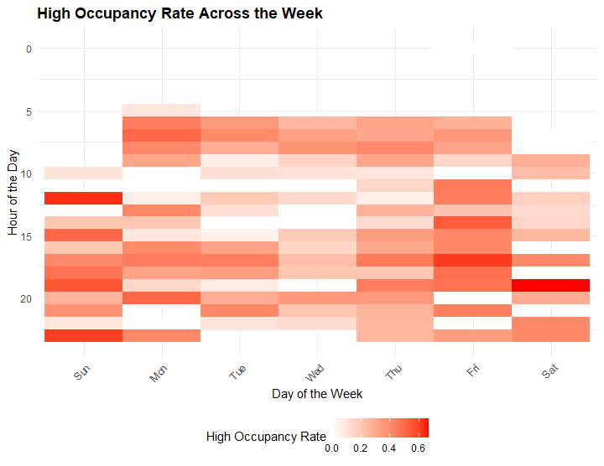
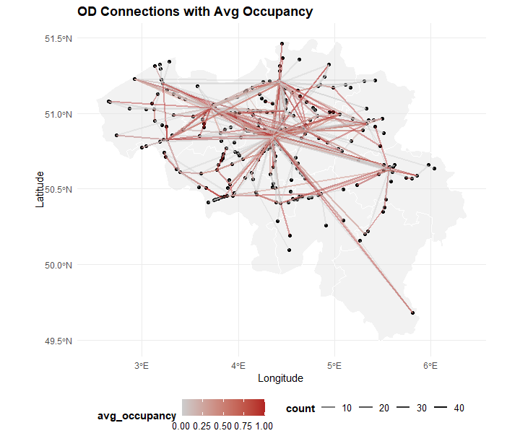
Most Important: Good Data!

Slide 9
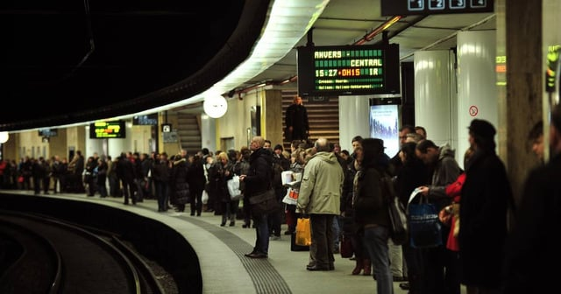
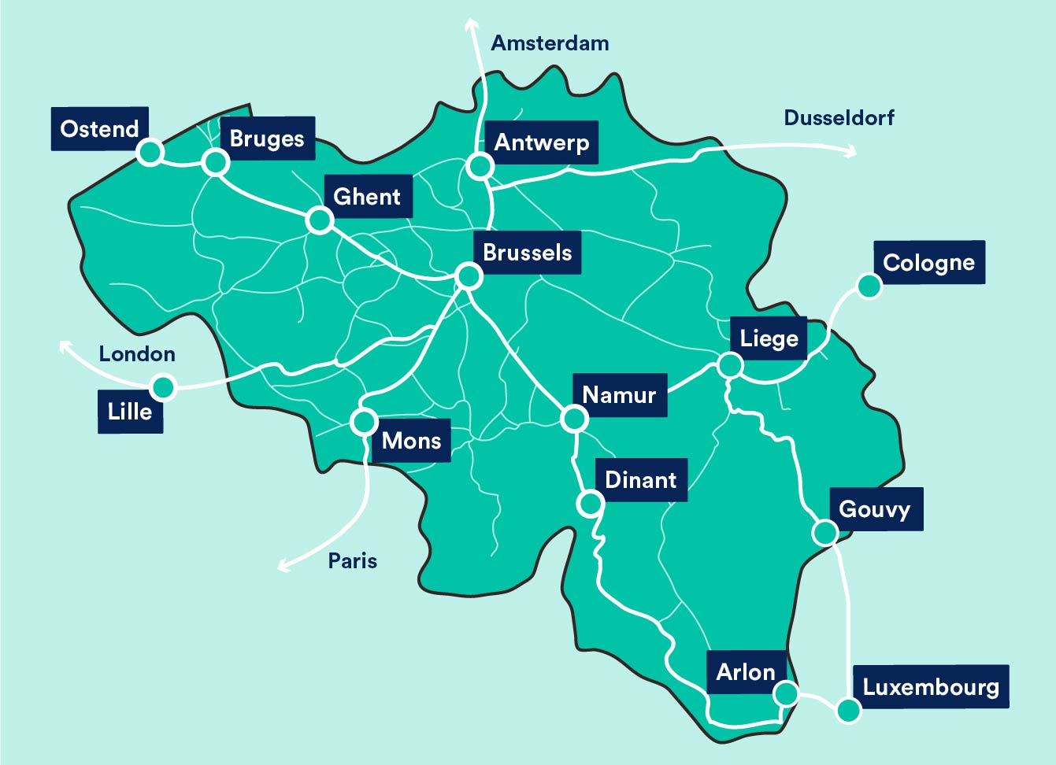
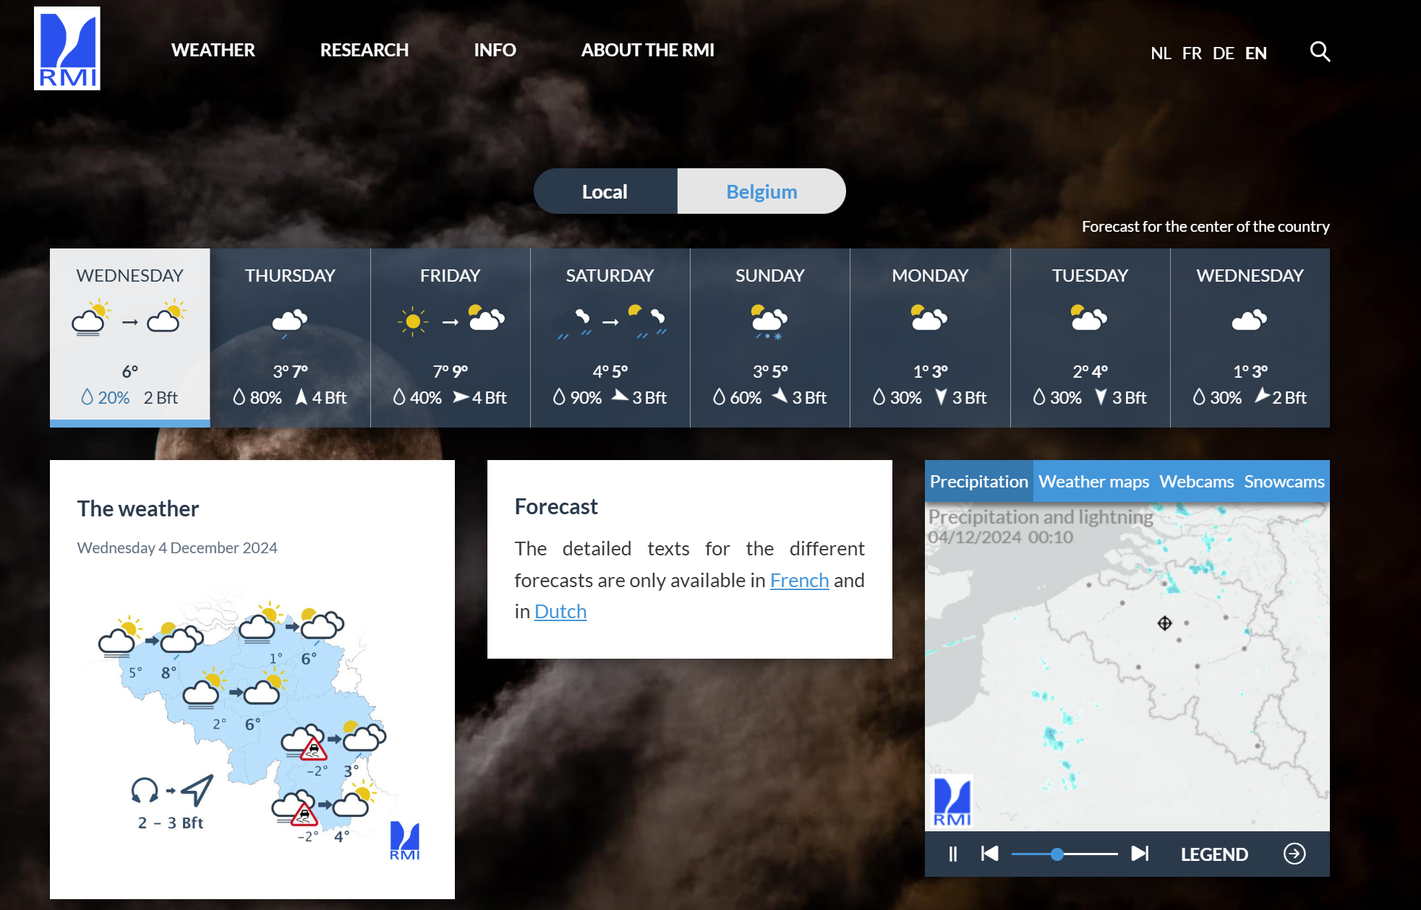
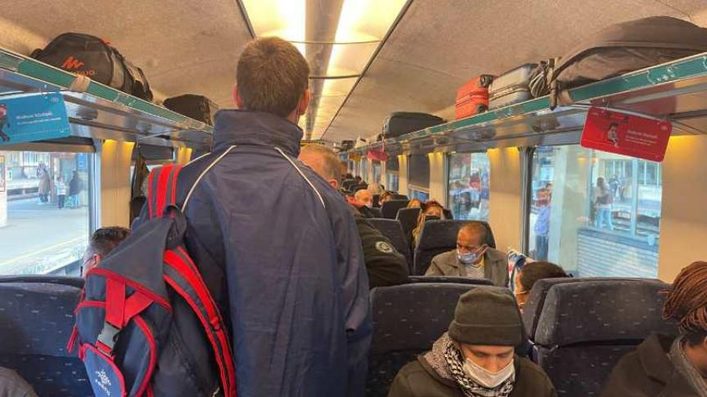
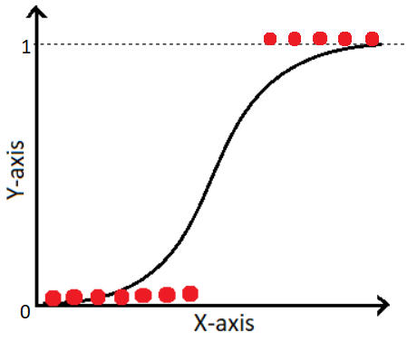

Goal: Predict High-Occupancy Trains

Slide 10
Feature Engineering
Day
Time
Day/Time
Mon
12 AM
Mon/Morning
Mon/Noon
Tue
1 AM
Tue/Morning
Tue/Noon
Wed
2 AM
Wed/Morning
Wed/Noon
From
To
Origin/Destination
Large
Large
Large/Large
Medium/Large
Medium
Medium
Large/Medium
Medium/Medium

Slide 11

OCCUPANCY DATA
TRAINING
TEST
MODEL
TEST
PREDICTION

Slide 12
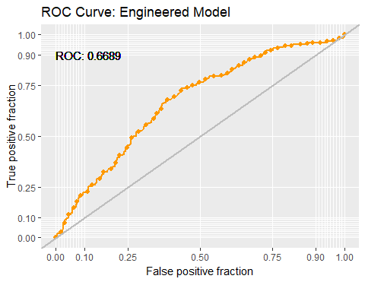
Early Model Results
Significant Variables
Mon/Noon, Tue/Noon, …
Sat/Morning, Sat/Noon, …
OD Small to Medium Stations
Local Trains, Other Trains
Accuracy | 0.66
Sensitivity | 0.40
Specificity | 0.78

Slide 13
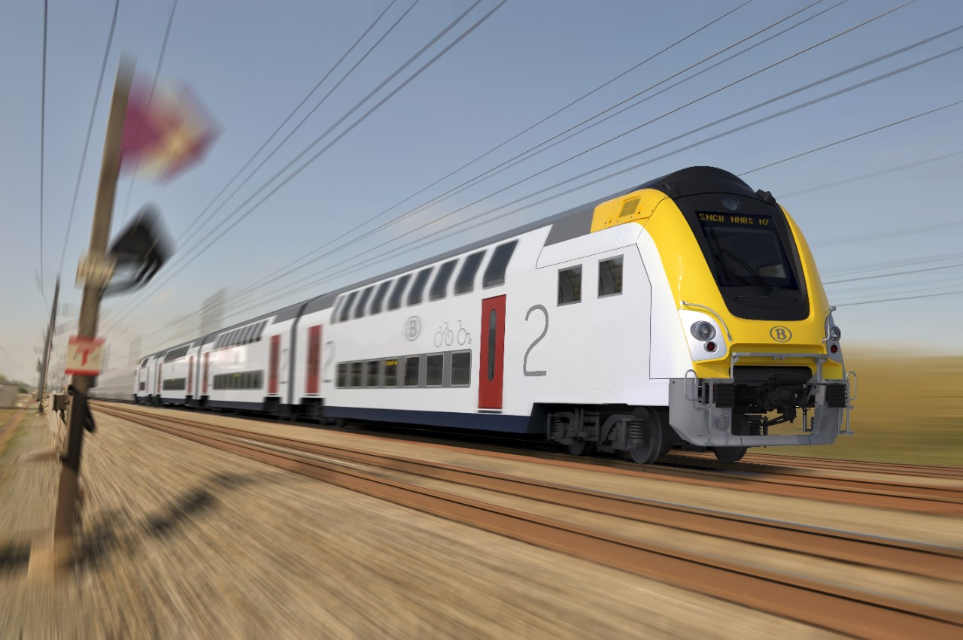

Future of Belgian Trains

